Slide 1
CS30500: Introduction to Software Engineering
Spring 2025
Ch 8. Requirements Modeling
Prof. In-Young Ko
School of Computing

Slide 2
Requirements Analysis

Slide 3
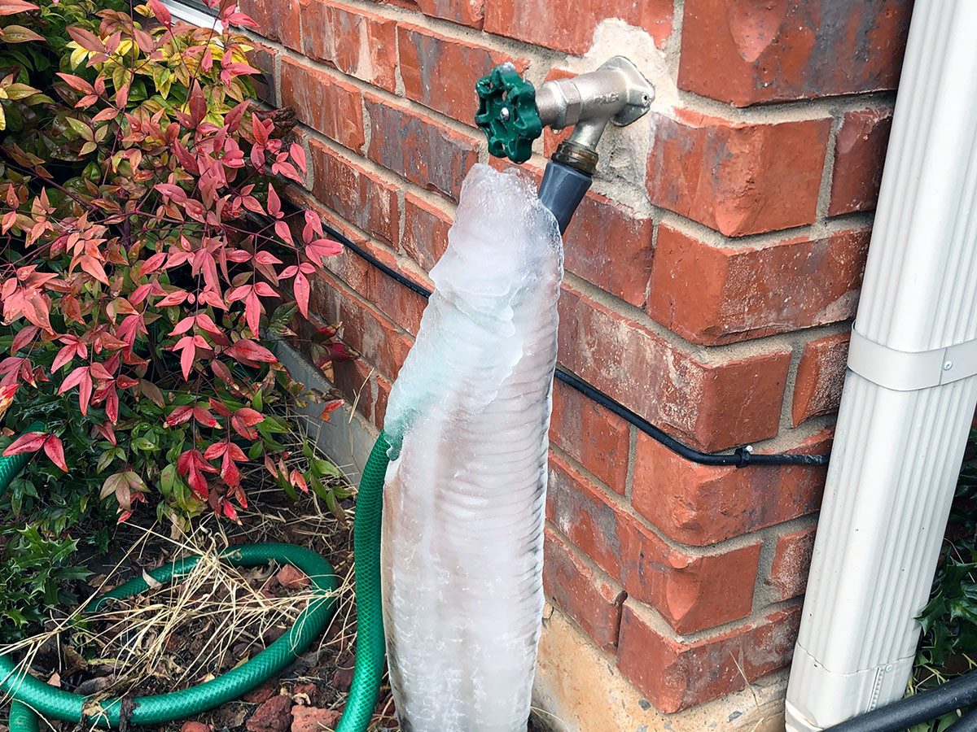

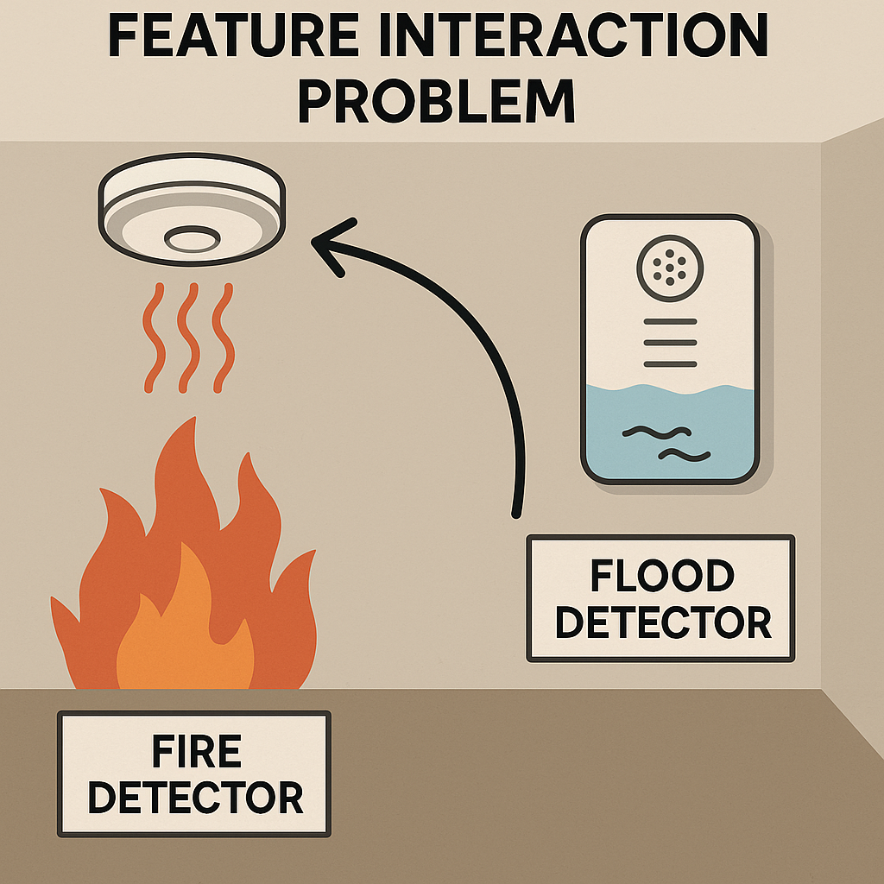

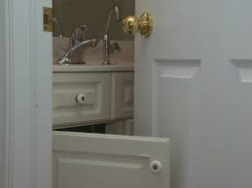
Requirements Problems 1/2
https://www.thespruce.com/prevent-an-outside-faucet-from-freezing-4125741
https://storables.com/articles/what-to-do-if-outside-faucet-is-frozen/
https://www.homesandgardens.com/shopping/best-places-to-buy-bathroom-vanities
https://gjconstructs.wordpress.com/2012/10/15/colliding-doors-bathroom-danger/

Slide 4
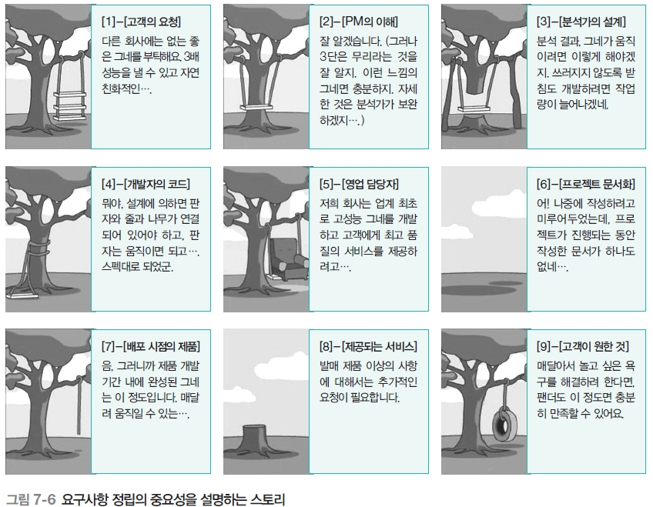
[1. Request of a customer]
I need a good swing, which is 3 time better than swings of other companies
[2. Understanding of a PM]
I understand (but I think that 3 time better is too much. I think this swing will be enough. The detail will be developed by designers)
[3. Design from a designer]
Ok, after analysis of customer’s request, I make a swing as follow. I need to make supports which costs more
[4. Code from a programmer]
According to a design spec, a board should be combined with a string and a tree and can move. My code satisfies the specification.
[5. Marketer]
My company has developed the world’s first high performance swing to provide best service and satisfaction…
[6. Project documentation]
Oh my ***. No documents have been written, as we delayed documentation for busy development schedule.
[7. Initial product release]
Well, an initial product came out of the given development schedule is as follows. It can swing with binding to a tree.
[8. Service provided]
Additional components should be purchased in addition to the released product
[9. What a customers really wants]
Panda will be happy with this swing
Fig 7-6 Example showing the importance of requirement elicitation (taken from 소프트웨어공학 이론과 실제)

Slide 6
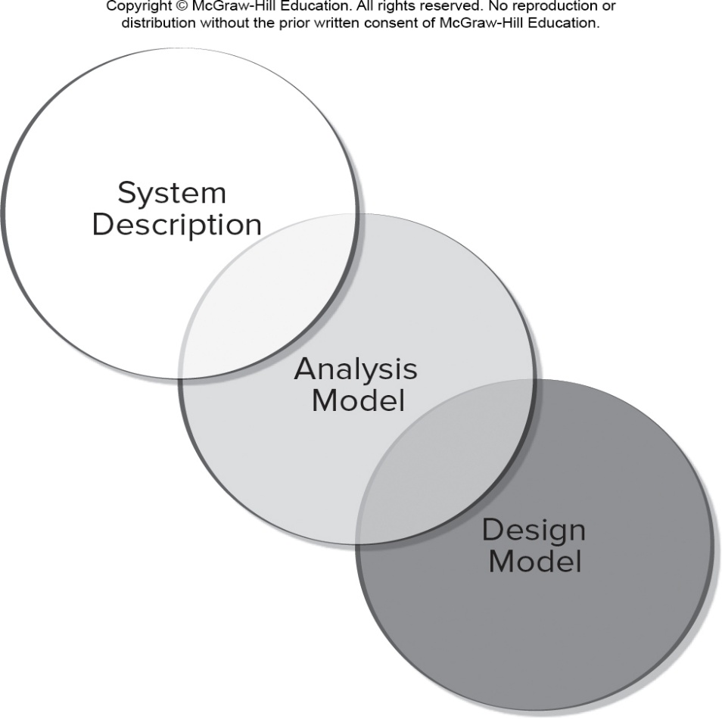
Requirements Analysis
Specifies software’s operational characteristics
Indicates software's interface with other system elements
Establishes constraints that software must meet
Requirements analysis allows the software engineer to:
Elaborate on basic requirements established during earlier requirement engineering tasks
Build models that depict the user’s needs from several different perspectives
A bridge
[PrMa20 ]

Slide 7
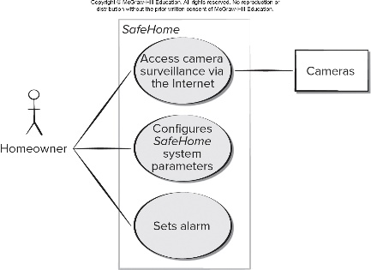
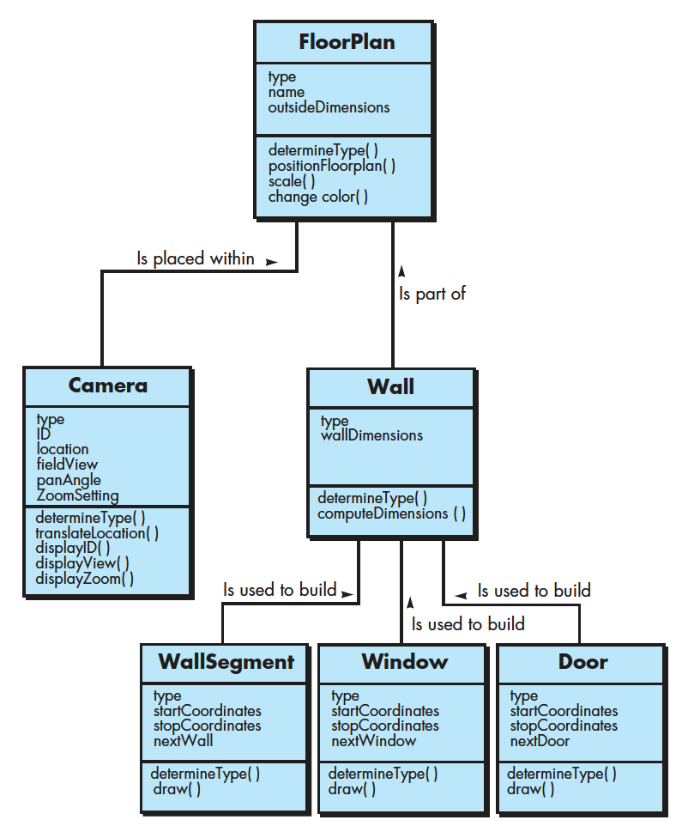
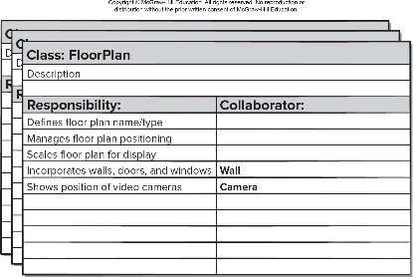
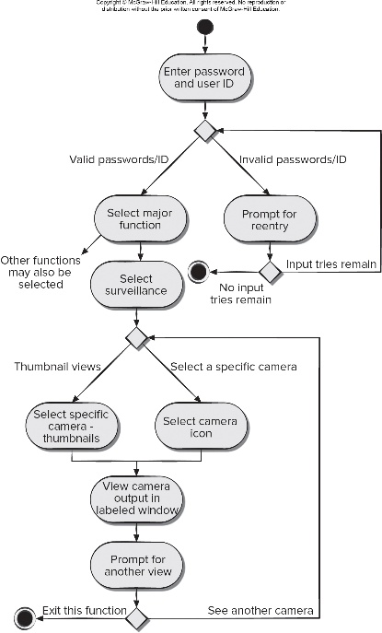
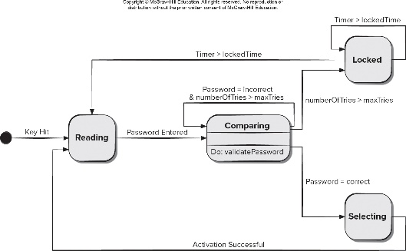
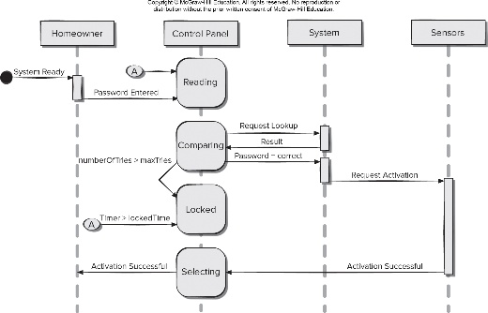
Requirements Models (1/2)
[PrMa20 ]
Scenario-based models
Depict requirements from the point of view of “actors”
e.g., storyboards, use case model
Class-oriented models
Represent object-oriented classes (attributes and operations) and how classes collaborate
e.g., class diagrams, CRC model
Behavioral models
Depict how the software reacts to internal or external “events”
e.g., control flow diagrams, Petri nets, sequence diagrams, activity diagrams, state diagrams

Slide 8
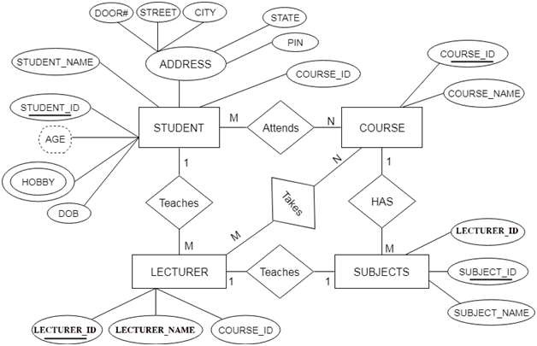
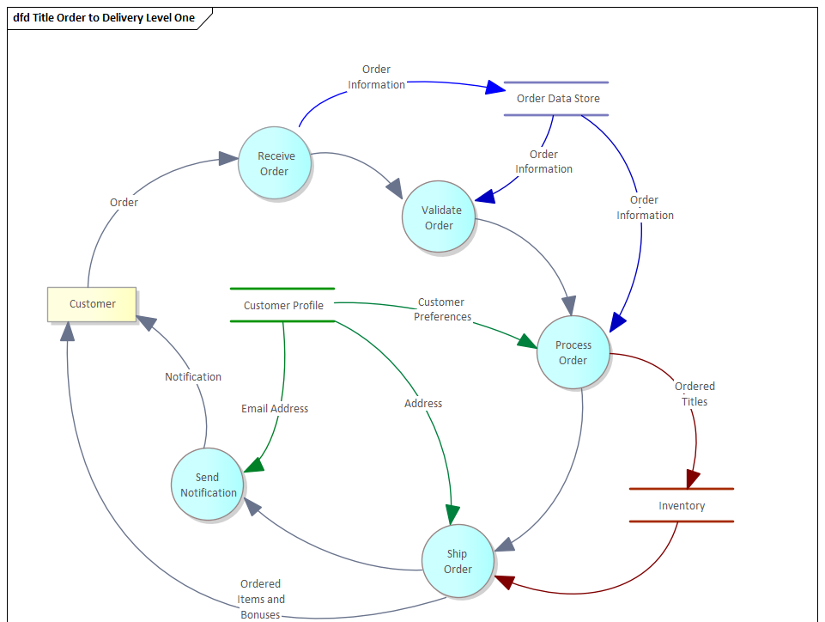
Requirements Models (2/2)
[PrMa20 ]
Data models
Depict the information domain for the problem
e.g., entity relationship (ER) diagrams, domain model (class diagrams)
Flow-oriented models
Represent functional elements and how they transform data
e.g., data flow diagrams
https://itwiki.kr/w/ER_%EB%8B%A4%EC%9D%B4%EC%96%B4%EA%B7%B8%EB%9E%A8
https://sparxsystems.com/enterprise_architect_user_guide/15.2/guidebooks/tools_ba_data_flow_diagram.html

Slide 9
Use Case Modeling

Slide 10
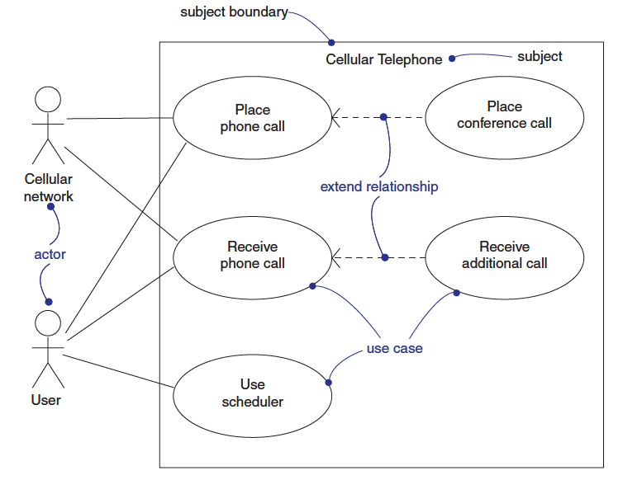
Use Case Diagram…
[BRJ05]

Slide 11
Use-Case Technique
Textual, structural, and visual modeling techniques for specifying use cases (Ivar Jacobson, 1986)
An object-oriented software engineering technique
For describing a system's behavior from the perspective of how the various users interact with the system
A user centric approach by which system behaviors can be explored with early user involvement
Use Case: describes a sequence of actions a system performs that yields a result of value to a particular actor
Use Case Model: consists of actors and various use cases by which the actors interact with the system
Describe functional behavior of the system, and relationships among use cases
[LeWi99]

Slide 12
Use Case Modeling
Use case model is the collection of diagrams, descriptions needed to represent the use cases and actors
Use case modeling process
Defines the system boundary
Finds the actors
Finds the use cases
Describes each use case
Refactors the use case model
Prioritizes use cases
Adds future requirements (change cases)
Organizes the use case model (packages)
The content of this slide is adopted from the lecture materials of the Methods course (17-652) at Carnegie Mellon University.
Notes:
Redundant use case → complexity increase → needs refactoring
Prioritizing by numbering use cases

Slide 13
System Diagram (Context Diagram)
Describes the system boundaries and identifies the actors of the system
Creating a system diagram is the first step in use-case modeling
The System
[LeWi99]

Slide 14
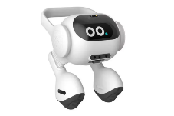
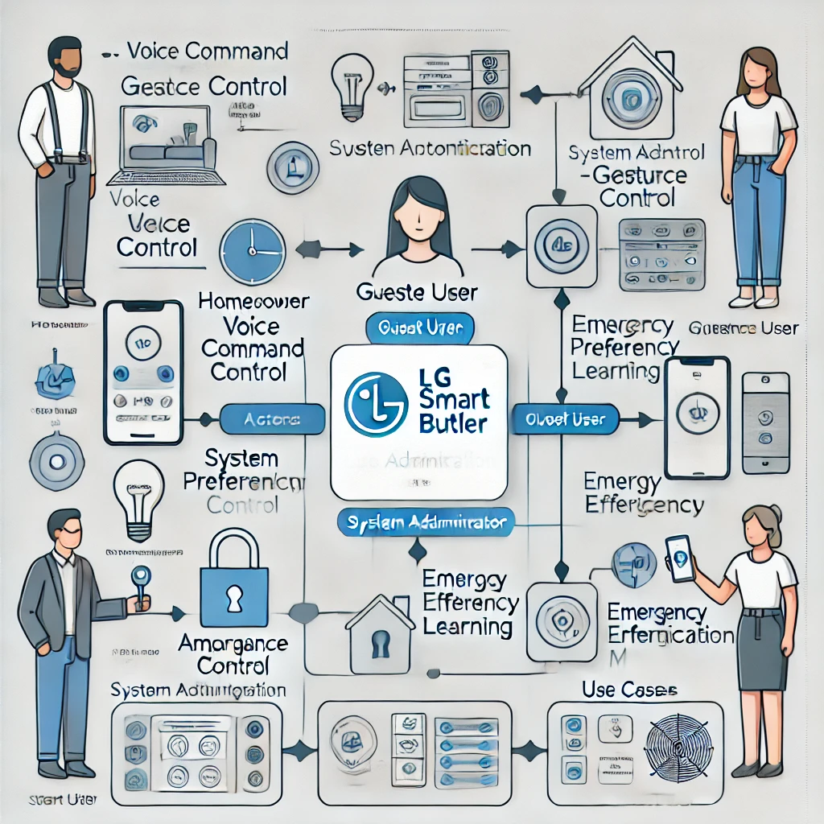
Vision Diagram Generated by ChatGPT

Slide 15
Actors
Actor: an entity that interacts with the system
The stakeholders that interact with the system influence how it may be designed
Software development is seldom from scratch, often there are multiple interacting components where the new application is the member of a larger collaborative scenario of multiple applications
Defining the actors helps define the boundaries of the system
Actors that interact with the system are roles, i.e. generally defined designations, not specific people or instances
The content of this slide is adopted from the lecture materials of the Methods course (17-652) at Carnegie Mellon University.

Slide 16
Use Cases
Use Case
A use case is a story about some way of using a system to do something useful
Captures a contract between the stakeholders of a system about its behavior [Coc01]
Describes what the system does at a conceptual level
A use case is goal oriented
Not necessarily functionality oriented, but functionality covers a lot of the use cases
A use case outlines a single goal and all the possible things that can happen as the users tries to reach that goal
Use cases are not simply menu items or functions
The content of this slide is adopted from the lecture materials of the Methods course (17-652) at Carnegie Mellon University.

Slide 17
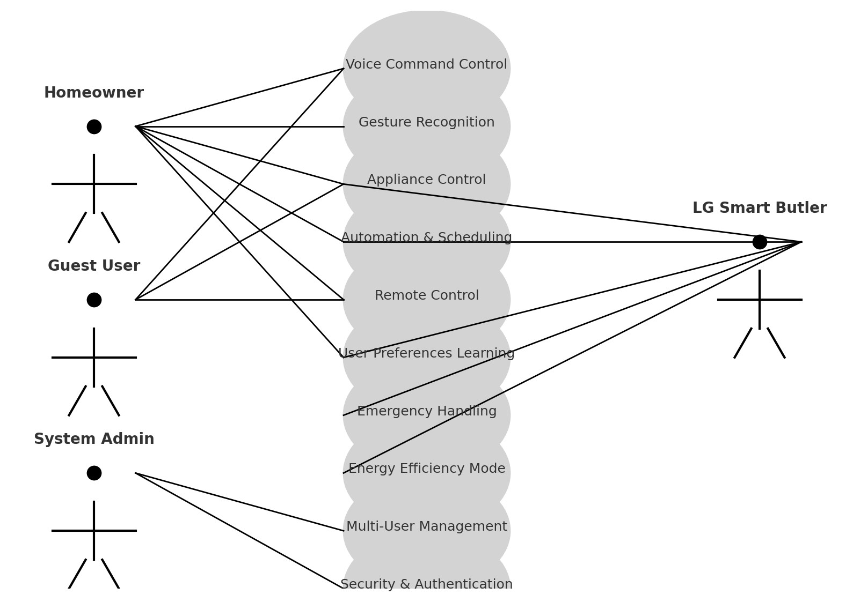
Use Case Diagram Generated by ChatGPT

Slide 18
Describing Use Cases

Slide 19
Describing a Use Case (1/2)
Describing in text the detailed sequence interaction between an actor and the system
An important requirement elicitation tool
The templates give guidance for the thinking process
Which actor(s), other use cases that initiate the use case
What are the preconditions of the use case
How does the use case proceed (the flow of events)
What happens once the use case is over, what are the post conditions
What are the alternative sequences of events (exceptions), what are the decision points that may lead the user into alternative paths
The content of this slide is adopted from the lecture materials of the Methods course (17-652) at Carnegie Mellon University.

Slide 20
Use Case Description Example
Name | Make reservation
Summary | Reservation clerk reserves a room for a hotel guest
Actor | Reservation clerk
Precondition | Reservation clerk has logged into the Hotel system
Description | Guest gives personal details to reservation clerk, such as name, room type, number of occupants, and dates and times of arrival and departure Reservation clerk enters information into the system and looks up availability and room reservation rate If room is available, clerk requests the guest to guarantee the reservation with a credit card number The clerk enters the guest’s credit card number to guarantee the reservation. If credit card number is valid, the clerk updates the reservation as guaranteed.
Alternatives | Room not available: Line 3: If a room is not available, clerk requests the customer for another date and / or time of arrival and departure Invalid card: Line 5: If the credit card number is not valid, the clerk requests the customer for another credit card number
Postcondition | The reservation is created for the guest.
Gomaa, H., & Olimpiew, E. M. (2005). The role of use cases in requirements and analysis modeling. In Workshop on Use Cases in Model-Driven Software Engineering. Montego Bay, Jamaica.

Slide 21
Use Case Description Example
Name | Make reservation
Summary | Reservation clerk reserves a room for a hotel guest
Actor | Reservation clerk
Precondition | Reservation clerk has logged into the Hotel system
Description | Guest gives personal details to reservation clerk, such as name, room type, number of occupants, and dates and times of arrival and departure Reservation clerk enters information into the system and looks up availability and room reservation rate If room is available, clerk requests the guest to guarantee the reservation with a credit card number The clerk enters the guest’s credit card number to guarantee the reservation. If credit card number is valid, the clerk updates the reservation as guaranteed.
Alternatives | Room not available: Line 3: If a room is not available, clerk requests the customer for another date and / or time of arrival and departure Invalid card: Line 5: If the credit card number is not valid, the clerk requests the customer for another credit card number
Postcondition | The reservation is created for the guest.
[GoOi05] Gomaa, H., & Olimpiew, E. M. (2005). The role of use cases in requirements and analysis modeling. In Workshop on Use Cases in Model-Driven Software Engineering. Montego Bay, Jamaica.

Slide 22
Use Case Description Generated by ChatGPT (1/2)
Use Case: Voice Command Control
1. Use Case ID: UC-VC-001
2. Use Case Name: Voice Command Control
3. Actors
Primary Actor: User (Homeowner, Resident)
Secondary Actors: LG Butler Robot, Smart Home Appliances (e.g., Air Conditioner, Refrigerator, Washing Machine, Oven)
4. Description
This use case describes how the LG Butler Robot allows users to control and coordinate smart home appliances using voice commands. The butler robot listens to user commands, processes them using natural language understanding (NLU), and sends instructions via APIs to the relevant home appliances for execution.
5. Preconditions
The LG Butler Robot is powered on and connected to the home network.
Smart home appliances are registered, online, and integrated with the LG ThinQ platform.
The user has an authenticated profile in the system.
Voice recognition is enabled and trained to recognize the user's voice.
6. Postconditions
The requested action is successfully performed, and feedback is provided to the user.
In case of failure, the user is notified with an appropriate message.

Slide 23
Use Case Description Generated by ChatGPT (2/2)
7. Main Flow
User initiates voice command (e.g., “Turn on the air conditioner to 22°C.”).
LG Butler Robot captures and processes the voice command using speech recognition and NLU.
Command validation: The system verifies user authentication and checks if the requested appliance is available and online.
Command execution:
If valid, the butler robot sends the instruction via API to the corresponding appliance.
The appliance processes the request and changes its state accordingly.
Feedback to user:
The butler robot confirms that the action has been executed successfully (e.g., “The air conditioner has been set to 22°C.”).
If an issue occurs (e.g., device offline), the butler robot informs the user (e.g., “The air conditioner is currently unavailable.”).
8. Alternative Flows
8.1. Invalid or Unrecognized Command
The butler robot requests clarification (e.g., “I didn’t understand. Could you please repeat?”).
8.2. Appliance Unavailable
The system notifies the user that the requested appliance is offline or unresponsive.
8.3. User Authentication Failure
If the user is not recognized, the system prompts for authentication before proceeding.

Slide 24
Use Case Template & Sample
Cockburn’s Use Case Template & Sample:
https://home.cs.colorado.edu/~kena/classes/6448/s01/examples/edmonb3.pdf

Slide 25
Use Case Scenario Examples

Slide 26
Use Case Scenarios
Use cases describe abstract and general behavior
Use cases do not describe what happens when a specific actor performs a specific action with specific values
Scenarios: specific executions ➔ also denoted as use case instances
Variations of input and output parameters
Variations on flow of events
Scenarios carry use cases to a larger requirement elicitation context
Validate requirements
Identify any unaddressed nonfunctional requirements
Performance and usability commonly
Create a broader system prototype
Flow nicely into test cases
Success and failure scenarios (primary and secondary use cases)
The content of this slide is adopted from the lecture materials of the Methods course (17-652) at Carnegie Mellon University.
Notes:
The relationship between use cases and use case instances is similar to the relationship between an object class and its object instances.

Slide 27
Use Case Scenario Generated by ChatGPT
Primary (Main) Scenario for “Voice Command Control”:
User activates the system using a wake word (e.g., "Hey LG").
System detects the wake word and starts listening.
User gives a voice command (e.g., "Turn on the air conditioner").
System processes the command using speech-to-text conversion.
System interprets the command and identifies the corresponding appliance.
System executes the command and provides feedback (voice or display).
System confirms successful execution to the User.

Slide 28
Alternative Use Case Scenarios Generated by ChatGPT
1. Incorrect Wake Word Detection
1.1 User tries to wake up the system with an unrecognized phrase.
1.2 System does not activate or asks the user to repeat.
1.3 User retries with the correct wake word, and the system proceeds as normal.
2. Ambiguous Command Given
2.1 User says, "Turn it on."
2.2 System cannot determine which appliance is being referred to.
2.3 System asks for clarification (e.g., "Which device would you like to turn on?").
2.4 User provides a specific command, and the system executes it.
...
4. Background Noise Interference
4.1 User gives a command in a noisy environment.
4.2 System misinterprets the command or does not recognize it.
4.3 System asks the user to repeat the command.
4.4 If the environment remains too noisy, the system suggests using manual input instead.

Slide 29
Use Case Modeling for Your Project (Individual Practice)
Goal: Describe the requirements of a subsystem of your project by doing use case modeling
Purpose:
Exercise use case modeling by using a UML tool
Suggested outline of the outcome
Give a brief description of your problem (subsystem)
Identify and briefly describe actors (not stakeholders)
Identify an initial set of use cases, structure the use case diagram
Write use case descriptions
Describe alternative scenarios for the use cases
➔ This outcome can be used for writing Software Requirements Specification (SRS) for your team project.

Slide 30
Conducting a Requirements Gathering Meeting (pg145)
The scene:
A meeting room. The first requirements gathering meeting is in progress.
The players:
Jamie Lazar, software team member;
Vinod Raman, software team member;
Ed Robbins, software team member;
Doug Miller, software engineering manager;
three members of marketing;
a product engineering representative;
a facilitator.
The conversation:
Facilitator (pointing at white board): So that's the current list of objects and services for the home security function.
Marketing person: That about covers it from our point of view.
Vinod: Didn't someone mention that they wanted all SafeHome functionality to be accessible via the Internet? That would include the home security function, no?
Marketing person: Yes, that's right ... we'll have to add that functionality and the appropriate objects.
30
CS350 Intro. to SE Spring 2008

Slide 31
Facilitator: Does that also add some constraints?
Jamie: It does, both technical and legal.
Production rep: Meaning?
Jamie: We better make sure an outsider can't hack into the system, disarm it, and rob the place or worse. Heavy liability on our part.
Doug: Very true.
Marketing: But we still need Internet connectivity. Just be sure to stop an outsider from getting in.
Ed: That's easier said than done and....
Facilitator (interrupting): I don't want to debate this issue now. Let's note it as an action item and proceed. (Doug, serving as the recorder for the meeting, makes an appropriate note.)
Facilitator: I have a feeling there's still more to consider here.
(The group spends the next 45 minutes refining and ex­panding the details of the home security function.)
31
CS350 Intro. to SE Spring 2008

Slide 32
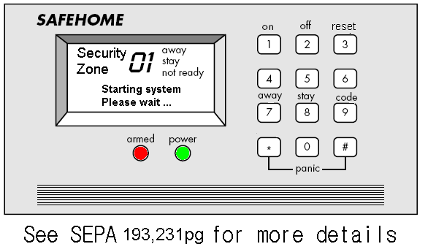
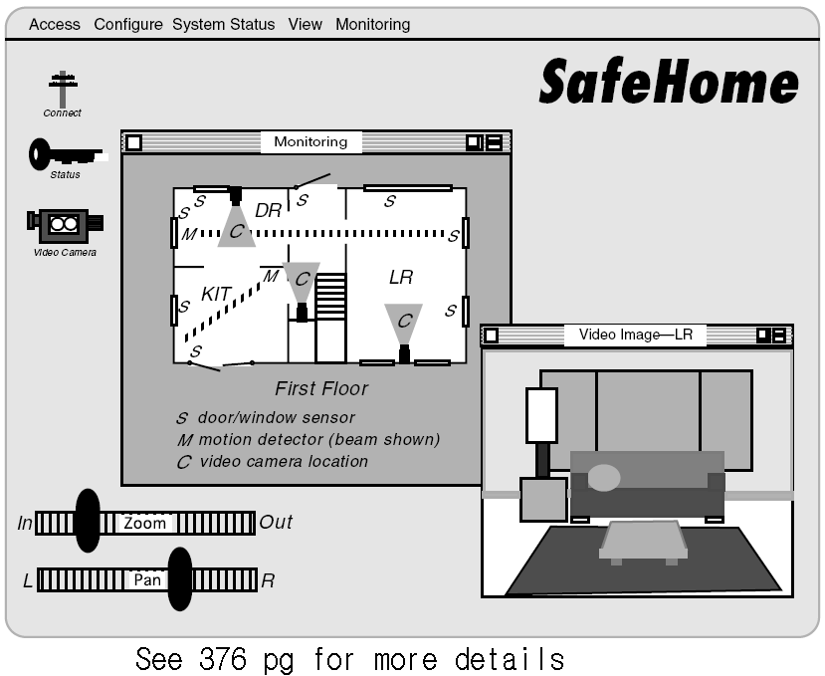
SafeHome Product

Slide 33
Use-Cases
A collection of user scenarios that describe the thread of usage of a system
Each scenario is described from the point-of-view of an “actor”—a person or device that interacts with the software in some way
Each scenario answers the following questions:
Who is the primary actor, the secondary actor (s)?
What are the actor’s goals?
What preconditions should exist before the story begins?
What main tasks or functions are performed by the actor?
What extensions might be considered as the story is described?
What variations in the actor’s interaction are possible?
What system information will the actor acquire, produce, or change?
Will the actor have to inform the system about changes in the external environment?
What information does the actor desire from the system?
Does the actor wish to be informed about unexpected changes?

Slide 34
Example of Use Case for SafeHome
Use-case: InitiateMonitoring
Primary actor: Homeowner
Goal in context: To set the system to monitor sensors when the homeowner leaves the house or remains inside
Preconditions: System has been programmed for a password and to recognize various sensors
Trigger: The homeowner decides to “set” the system, i.e., to turn on the alarm functions
Scenario:
Homeowner: observes control panel
Homeowner:enters password
Homeowner: selects “stay” or “away”
Homeowner: observes red alarm light to indicate that SafeHome has been armed
Exceptions:
1a. Control panel is not ready: homeowner checks all sensors to determine which are open; closes them
2a. Password is incorrect
Priority: Essential, must be implemented
When available: first increment
Frequency of use: Many times per day
Channel to actor: Via control panel interface
Secondary actors: Support technician
Channels to secondary actors: support technician: phone line
Open issues:
Do we enforce time limit for password entering?

Slide 35
Use-Case Diagram

Slide 36
Building the Analysis Model
Elements of the analysis model
Scenario-based elements
Functional—processing narratives for software functions
Use-case—descriptions of the interaction between an “actor” and the system
Class-based elements
Implied by scenarios
Behavioral elements
State diagram

Slide 37
Eliciting Requirements

Slide 38
Class Diagram
From the SafeHome system …

Slide 39
State Diagram

Slide 40
Negotiating Requirements
Identify the key stakeholders
These are the people who will be involved in the negotiation
Determine each of the stakeholders “win conditions”
Win conditions are not always obvious
Negotiate
Work toward a set of requirements that lead to “win-win”

Slide 41
Validating Requirements-I
Is each requirement consistent with the overall objective for the system/product?
Have all requirements been specified at the proper level of abstraction? That is, do some requirements provide a level of technical detail that is inappropriate at this stage?
Is the requirement really necessary or does it represent an add-on feature that may not be essential to the objective of the system?
Is each requirement bounded and unambiguous?
Does each requirement have attribution? That is, is a source (generally, a specific individual) noted for each requirement?

Slide 42
Validating Requirements-II
Do any requirements conflict with other requirements?
Is each requirement achievable in the technical environment that will house the system or product?
Is each requirement testable, once implemented?
Does the requirements model properly reflect the information, function and behavior of the system to be built.
Has the requirements model been “partitioned” in a way that exposes progressively more detailed information about the system.

Slide 43
Specification Guidelines
use a layered format that provides increasing detail
as the "layers" deepen
use consistent graphical notation and apply textual
terms consistently (stay away from aliases)
be sure to define all acronyms
be sure to include a table of contents; ideally,
include an index and/or a glossary
write in a simple, unambiguous style (see "editing
suggestions" on the following pages)
always put yourself in the reader's position, "Would
I be able to understand this if I wasn't intimately
familiar with the system?"

Slide 44
Specification Guidelines

Slide 45
Specification Guidelines

Slide 46
Questions?

